Slide 1
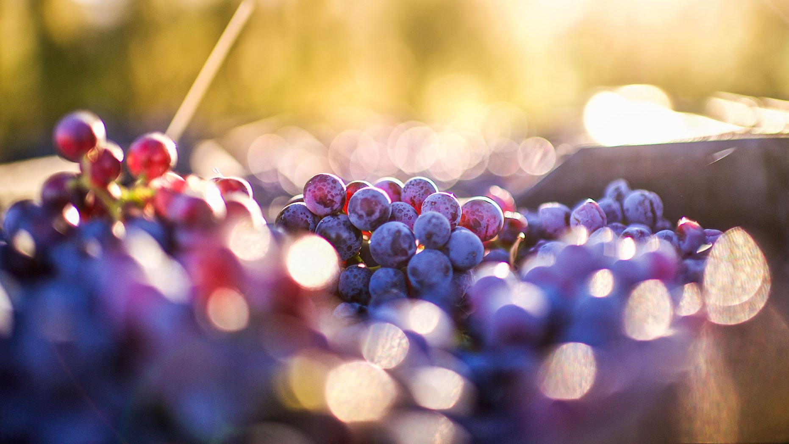
Deep Learning for Wine Quality Prediction: Neural Network Optimization and Performance Analysis
By Aaron Niecestro
Notes:
This project applies multiple unsupervised machine learning techniques to understand the underlying structure of wine chemistry data.
The analysis investigates clustering behavior, nonlinear structure, dimensionality reduction, and anomaly detection using the UCI Wine Quality dataset.
The goal is to uncover patterns and relationships that exist without relying on target labels.

Slide 2
Project Objective
What is Deep Learning?
Deep Learning is a subset of machine learning that uses artificial neural networks with multiple hidden layers.
These networks learn complex nonlinear relationships directly from data.
Deep learning models automatically discover patterns and interactions that may be difficult to identify using traditional statistical approaches.
Goal
Develop and optimize neural network models capable of predicting wine quality from physicochemical measurements.
Objectives
Establish a baseline neural network model.
Evaluate the impact of feature scaling techniques.
Compare activation functions.
Compare neural network architectures.
Optimize epochs, optimizers, and regularization methods.
Identify the strongest overall model configuration.
Business Relevance
Understanding how wine chemistry influences quality can help support:
Quality assessment
Production consistency
Process optimization
Data-driven decision making
Why It Matters
Wine quality is influenced by complex interactions among acidity, alcohol, sulfur compounds, density, and other chemical properties.
Deep learning provides a powerful framework for learning these relationships and generating accurate quality predictions
Notes:
Unlike traditional machine learning approaches, deep learning uses interconnected layers of neurons capable of learning complex nonlinear patterns directly from data. The primary goal of this project is to determine how various neural network design decisions influence predictive performance when estimating wine quality. Multiple experiments were conducted, including feature scaling comparisons, activation function evaluations, architecture optimization, epoch studies, optimizer benchmarking, and regularization analysis, culminating in the selection of a final optimized deep learning model.

Slide 3
Dataset Description
Variable | Description | Was this Feature used for Modeling?
Fixed Acidity | Tartaric acid content | Yes
Volatile Acidity | Acetic acid concentration | Yes
Citric Acid | Citric acid level | Yes
Residual Sugar | Remaining sugar | Yes
Chlorides | Salt concentration | Yes
Free Sulfur Dioxide | SO₂ level | Yes
Total Sulfur Dioxide | Total SO₂ | Yes
Density | Wine density | Yes
pH | Acidity measure | Yes
Sulphates | Sulfate concentration | Yes
Alcohol | Alcohol percentage | Yes
Quality | Wine quality score | Used for interpretation and evaluation
Type | Red or White | Used for interpretation and evaluation
UCI Wine Quality Dataset
Physicochemical measurements collected from Portuguese Vinho Verde wines.
Dataset Size
5,320 observations
11 chemistry features
Quality scores from 3 to 9
Input Features
Acidity measurements
Sugar content
Sulfur dioxide levels
Density
pH
Alcohol concentration
Target Variable
Wine Quality
Predicted using neural networks
Interpretation
The dataset contains numerical chemistry measurements describing the physical and chemical composition of both red and white wines. These measurements serve as inputs to the neural network, while quality scores act as the prediction target.
Notes:
The Wine Quality dataset contains physicochemical measurements collected from red and white Portuguese Vinho Verde wines.
The analysis focuses on eleven chemistry variables that describe acidity, sugar content, sulfur concentration, density, and alcohol content.
Wine type and quality were intentionally excluded from most unsupervised methods and later used for interpretation to determine whether natural structures aligned with known wine categories.
A key advantage of this dataset is that it enables us to evaluate whether meaningful groups emerge naturally from
chemistry alone.

Slide 4
Brief View of Wine Data
Metric | Value
Observations | 5,320
Features | 11 Chemistry Variables
Wine Types | Red & White
Quality Range | 3-9
Avg Alcohol | 10.55%
Avg Residual Sugar | 5.05 g/dm³
Avg pH | 3.22
Avg Total Sulfur Dioxide | 114.11 mg/dm³
Variable | Mean | Range
Fixed Acidity (g/dm³) | 7.22 | 3.8-15.9
Volatile Acidity (g/dm³) | 0.34 | 0.08-1.58
Residual Sugar (g/dm³) | 5.05 | 0.6-65.8
Total Sulfur Dioxide (mg/dm³) | 114.11 | 6-440
Density (g/cm³) | 0.9945 | 0.987-1.039
pH | 3.22 | 2.72-4.01
Alcohol (% Vol.) | 10.55 | 8.0-14.9

Slide 5
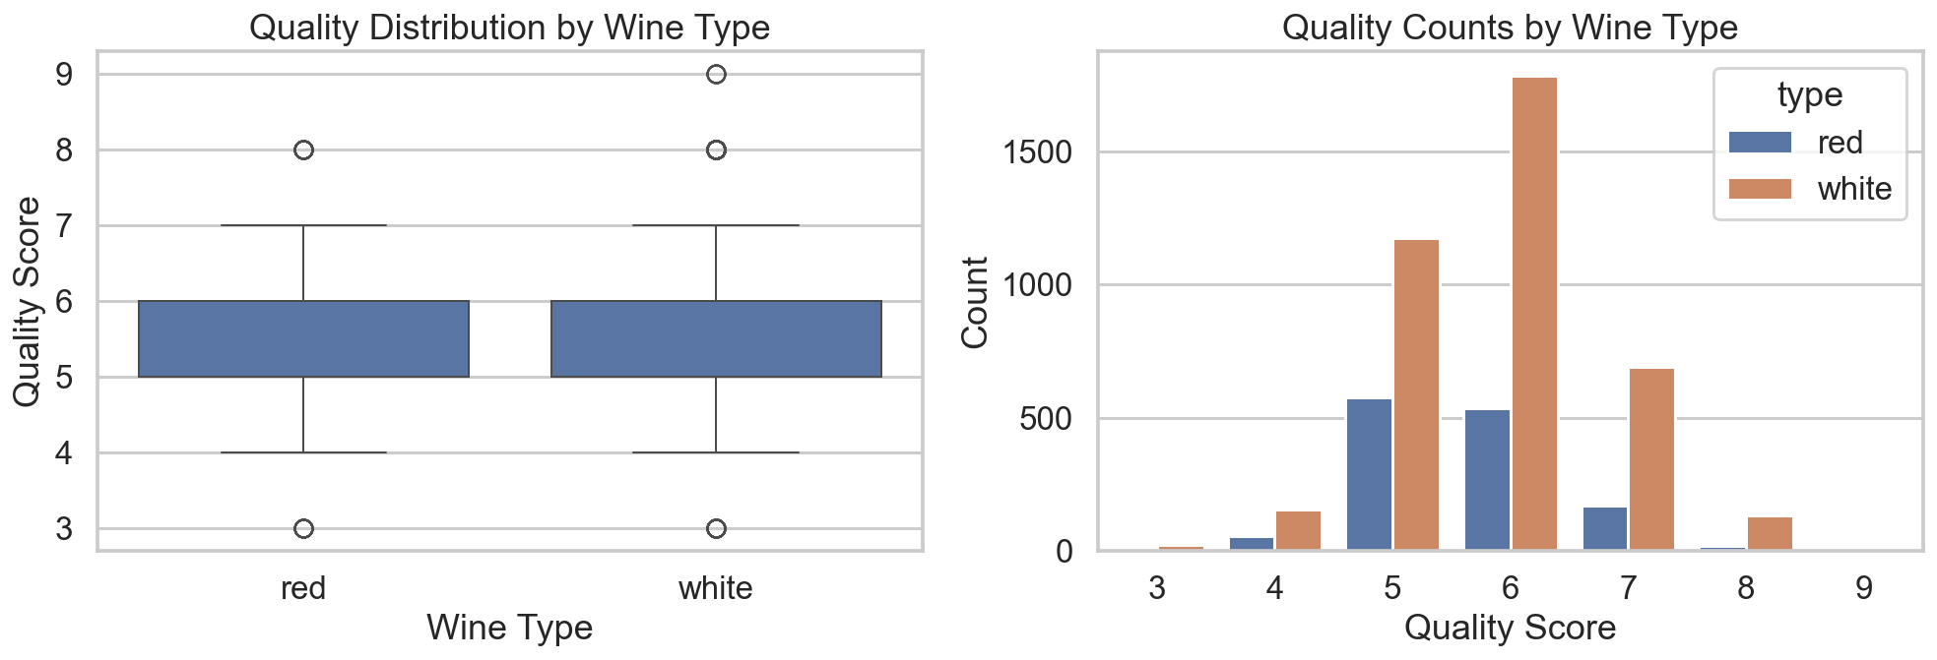
Wine Quality Distribution by Wine Type
Key Findings
Alcohol exhibited the strongest positive relationship with wine quality.
Volatile acidity showed a negative relationship with quality.
Several chemistry variables demonstrated meaningful correlations with the target variable.
Most wines were assigned quality scores between 5 and 6.
Interpretation
The observed relationships indicate that wine chemistry contains predictive information that can be leveraged by deep learning models.
Takeaway
Meaningful relationships exist between chemistry measurements and wine quality, supporting the use of neural networks for predictive modeling.
Notes:
Both wine types exhibited similar median quality scores andcomparable overall distributions.
Most wines received scores between 5 and 6, while very lowand very high quality ratings were relatively uncommon.This finding was important because it suggested early in theanalysis that wine quality might not be the dominant sourceof structure within the dataset.Later clustering and dimensionality-reduction analysesconfirmed this observation, showing that wine type drivesmuch stronger separation than quality.

Slide 6
Data Preparation & Analysis Approach
Data Preparation
Combined red and white wine datasets
Removed duplicate observations
Selected physicochemical predictors
Defined wine quality as the target variable
Modeling Workflow
Train/Test Split (80/20)
Feature Scaling Analysis
Activation Function Analysis
Architecture Comparison
Epoch Optimization
Optimizer Benchmarking
Regularization Analysis
Final Model Selection
Why This Matters
Neural networks are highly sensitive to feature scaling and architecture design.
A structured optimization workflow helps identify the most effective model configuration.
Notes:
Unlike traditional machine learning projects that often stop after selecting a model, this project systematically optimized multiple components of the neural network pipeline. Each analysis was designed to evaluate a specific aspect of model performance and contribute to the final recommended configuration.

Slide 7
Neural Networks Explained
What Is a Neural Network?
A machine learning model inspired by biological neurons.
Learns relationships between input features and target outcomes.
Uses hidden layers to capture nonlinear patterns.
Why Use Deep Learning?
Captures complex feature interactions.
Learns nonlinear relationships.
Adapts well to regression problems.
Evaluation Metrics
MAE (Mean Absolute Error)
RMSE (Root Mean Squared Error)
Adjusted R²
Training Loss
Validation Loss
Key Question
Which neural network configuration produces the strongest wine quality predictions?
Learning Curves
Notes:
Neural networks were selected because wine quality is influenced by many interacting chemical variables. Traditional linear methods may struggle to capture these nonlinear relationships, making deep learning an appropriate choice for this prediction task.

Slide 8
Model Evaluation Metrics
Prediction Accuracy
MAE → Average prediction error
RMSE → Error with emphasis on larger mistakes
Model Performance
Adjusted R² → Explanatory power
Higher values indicate a better fit
Training Behavior
Training Loss → Learning progress
Validation Loss → Generalization performance
Why These Metrics Matter
MAE & RMSE measure accuracy
Adjusted R² measures model fit
Loss metrics measure stability and generalization

Slide 9
Baseline Neural Network Model Selection
Objective
Determine whether a Perceptron or Multi-Layer Perceptron (MLP) provides stronger predictive performance for wine quality prediction.
Key Question
Does the added complexity of an MLP improve prediction performance enough to justify its use?
Perceptron
Single-layer neural network
Learns linear relationships
Simplest neural network architecture
Used as the baseline model
Multi-Layer Perceptron (MLP)
Contains one or more hidden layers
Learns complex nonlinear relationships
Greater modeling flexibility
Better suited for predictive modeling tasks
Why Compare Them?
Determine whether additional network complexity improves prediction accuracy.
Establish the most appropriate neural network foundation before optimization.

Slide 10
Initial Model Performance
Findings
MLP achieved lower MAE and RMSE than the Perceptron.
MLP produced a higher Adjusted R² (0.2924 vs. 0.2295).
Hidden layers improved the model's predictive capability.
Interpretation
Wine quality depends on nonlinear relationships that cannot be fully captured by a single-layer Perceptron.
The MLP was better able to learn complex interactions among wine chemistry variables.
Conclusion
Winner: Multi-Layer Perceptron (MLP)
Lower Prediction Error
Higher Adjusted R²
Stronger Predictive Performance
Model | MAE | RMSE | Adjusted R²
Perceptron | 0.5894 | 0.7686 | 0.2295
MLP | 0.5660 | 0.7365 | 0.2924

Slide 11
Feature Scaling Comparison
Objective
Determine how feature scaling influences neural network performance, convergence behavior, and predictive accuracy.
No Scaling
Uses raw feature values.
Preserves original measurement units.
Serves as the baseline preprocessing approach.
StandardScaler
Centers data around a mean of zero.
Scales features using standard deviation.
Commonly used with neural networks.
MinMaxScaler
Scales all features into the range of 0 to 1.
Preserves relative relationships between observations.
Frequently used when features have very different ranges.
Why Compare?
Neural networks use gradient-based optimization.
Large differences in feature magnitudes can negatively affect learning efficiency, convergence speed, and overall model performance.

Slide 12
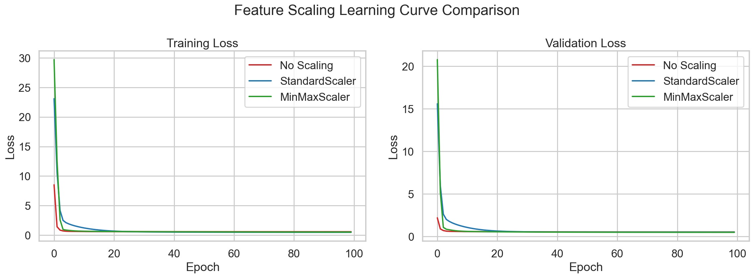
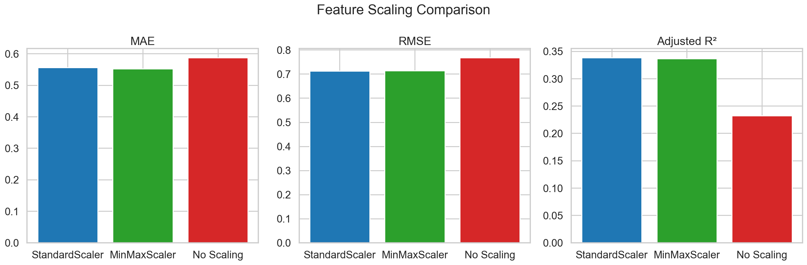
Feature Scaling Comparison Plots
Findings
StandardScaler achieved the best overall performance.
MinMaxScaler produced similar but slightly weaker results.
No Scaling resulted in higher error and lower Adjusted R².
Interpretation
Feature scaling improved both accuracy and model stability.
StandardScaler provided the most effective preprocessing strategy.
Conclusion
Winner: StandardScaler
Prediction Accuracy
Training Stability
Generalization
Best balance of:

Slide 13
Feature Scaling Conclusion
Conclusion
Scaling was one of the largest contributors to performance improvement.
Standardization improved both accuracy and model stability.
Neural networks benefited from features having consistent magnitudes.
Takeaway
Feature engineering and preprocessing decisions can influence performance as much as architectural decisions.
Key Insights
StandardScaler was selected for all subsequent analyses and became the foundation for the optimized deep learning pipeline.

Slide 14
Activation Functions
What Is an Activation Function?
Activation functions introduce nonlinearity into neural networks, allowing them to learn complex relationships between inputs and outputs.
Why Are They Important?
Without activation functions, neural networks would behave like simple linear models and lose much of their predictive power.
ReLU
Fast computation
Strong gradient propagation
Most common deep learning activation
Sigmoid
Produces outputs between 0 and 1
Historically important in neural networks
Can suffer from vanishing gradients
Tanh
Produces outputs between -1 and 1
Stronger gradients than Sigmoid
Often provides smoother learning dynamics

Slide 15
Activation Function Comparison
Objective
Determine which activation function provides the strongest predictive performance and training behavior.
Why Compare?
Activation functions influence:
Convergence speed
Stability
Predictive accuracy
Generalization performance
Evaluation Metrics
MAE
RMSE
Adjusted R²
Learning Curves
Validation Loss
Key Question
Which activation function is most effective for wine quality prediction?
Training Loss

Slide 16
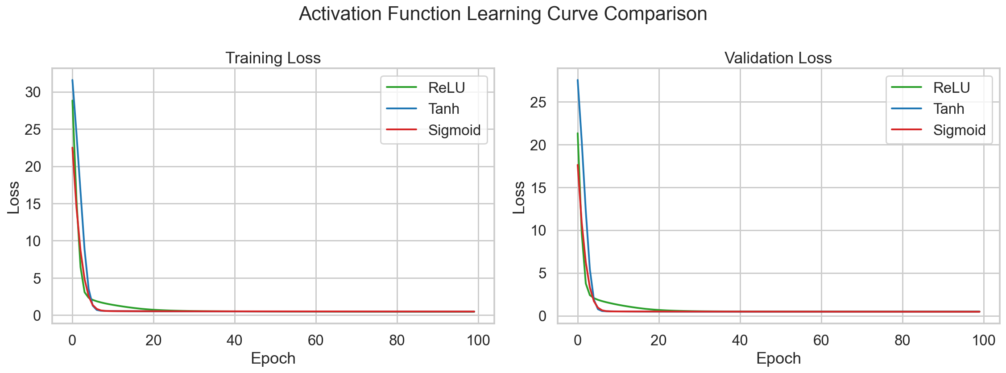
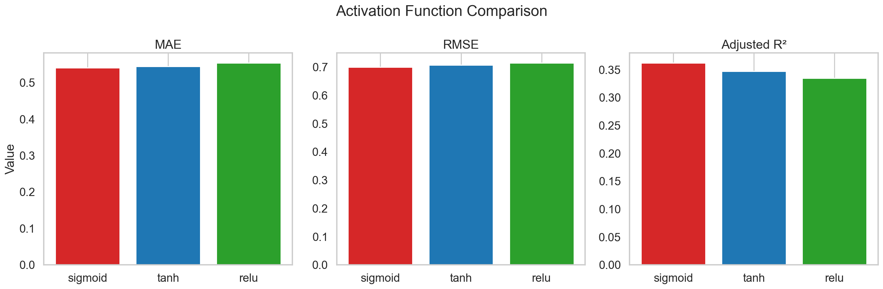
Activation Function Results
Findings
ReLU converged the fastest.
Sigmoid achieved the lowest MAE and RMSE and the highest Adjusted R².
Tanh produced competitive but weaker results.
All activation functions generalized effectively.
Interpretation
Faster convergence did not guarantee better predictive performance.
Sigmoid provided the strongest overall balance of accuracy and stability.
Conclusion
Winner: Sigmoid
Lowest error and highest Adjusted R².

Slide 17
Architecture Comparison
Objective
Evaluate how network depth and complexity influence predictive performance.
Why Compare Architectures?
The number of hidden layers and neurons determines a model's capacity to learn complex relationships.
Key Question
How much network complexity is necessary to accurately model wine quality?

Slide 18
Architectures Evaluated
Model A: 16
Model B: 32 → 16
Model C: 64 → 32 → 16
Model D: 128 → 64 → 32 → 16
Why These Architectures?
The architectures were intentionally designed with increasing complexity to evaluate whether additional layers and neurons improve predictive performance.
Evaluation Goal
Identify the architecture that achieves the strongest balance between:
Accuracy
Generalization
Training efficiency
Model complexity

Slide 19
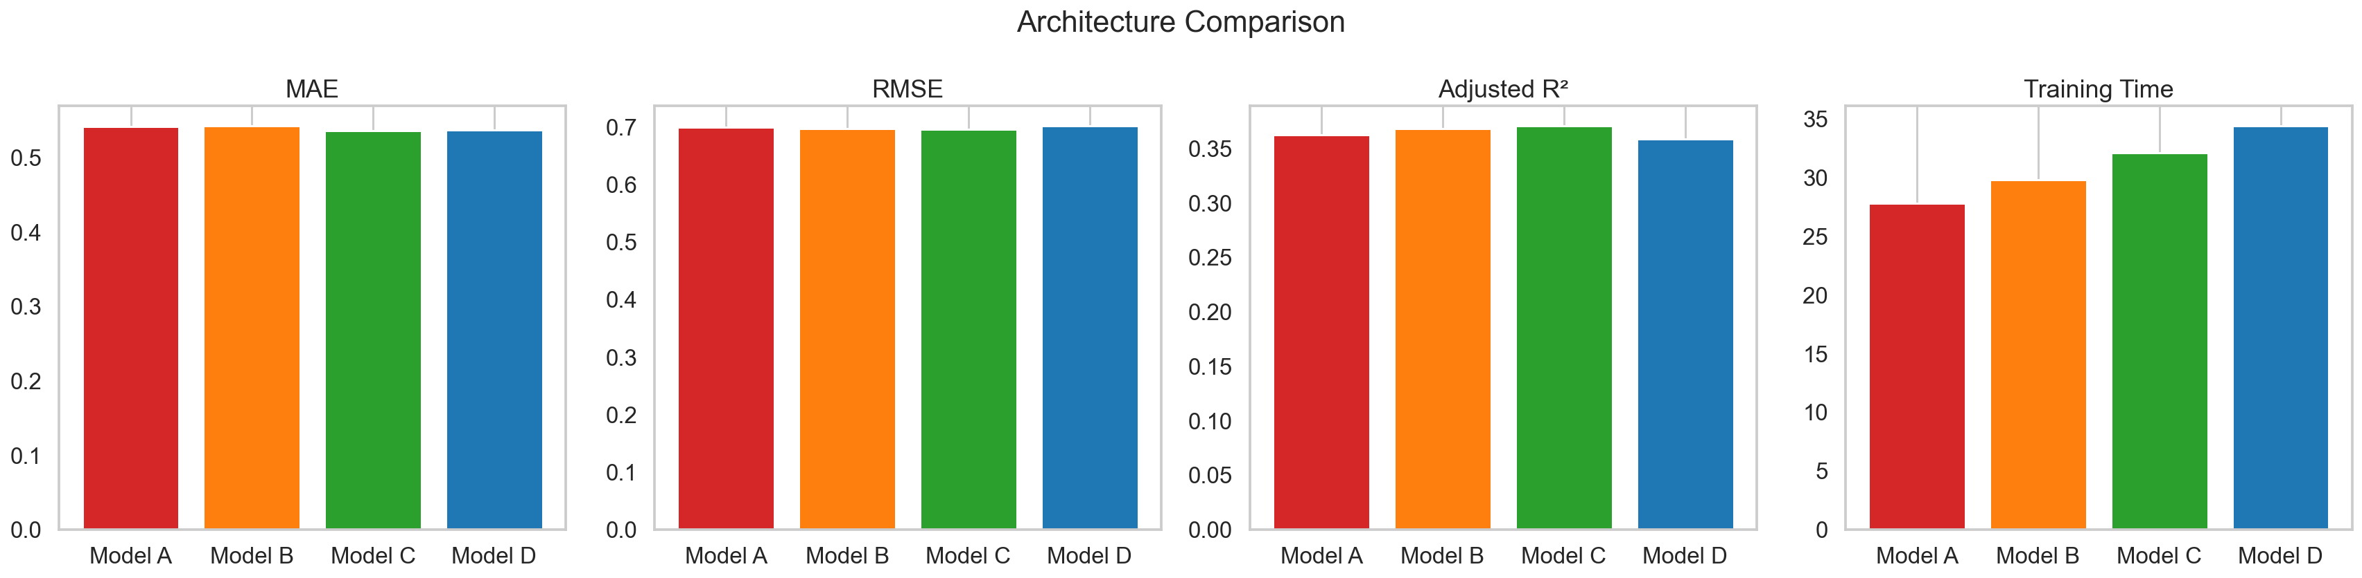
Architecture Results
Findings
Model C achieved the best overall performance.
Model D increased training time without improving accuracy.
Performance gains were modest across all architectures.
Training time increased as model complexity increased.
Interpretation
Increasing complexity improved performance up to Model C.
Additional layers beyond Model C produced diminishing returns.
Conclusion
Winner: Model C (64 → 32 → 16)
Strongest balance of performance and efficiency.

Slide 20
Epoch Optimization
Objective
Determine the optimal number of training epochs that maximizes predictive performance while maintaining strong model generalization.
What Is an Epoch?
One complete pass through the entire training dataset.
During each epoch, the neural network updates its weights to minimize prediction error.
Too few epochs may lead to underfitting.
Too many epochs may increase the risk of overfitting.
Epoch Range Evaluated at:
Why Compare?
Training duration directly influences:
Model accuracy
Convergence behavior
Generalization performance
Computational cost
Key Question
What number of epochs provides the strongest balance between predictive accuracy and training efficiency?
25,
50,
75,
100,
125,
150,
175, and
200 epochs

Slide 21
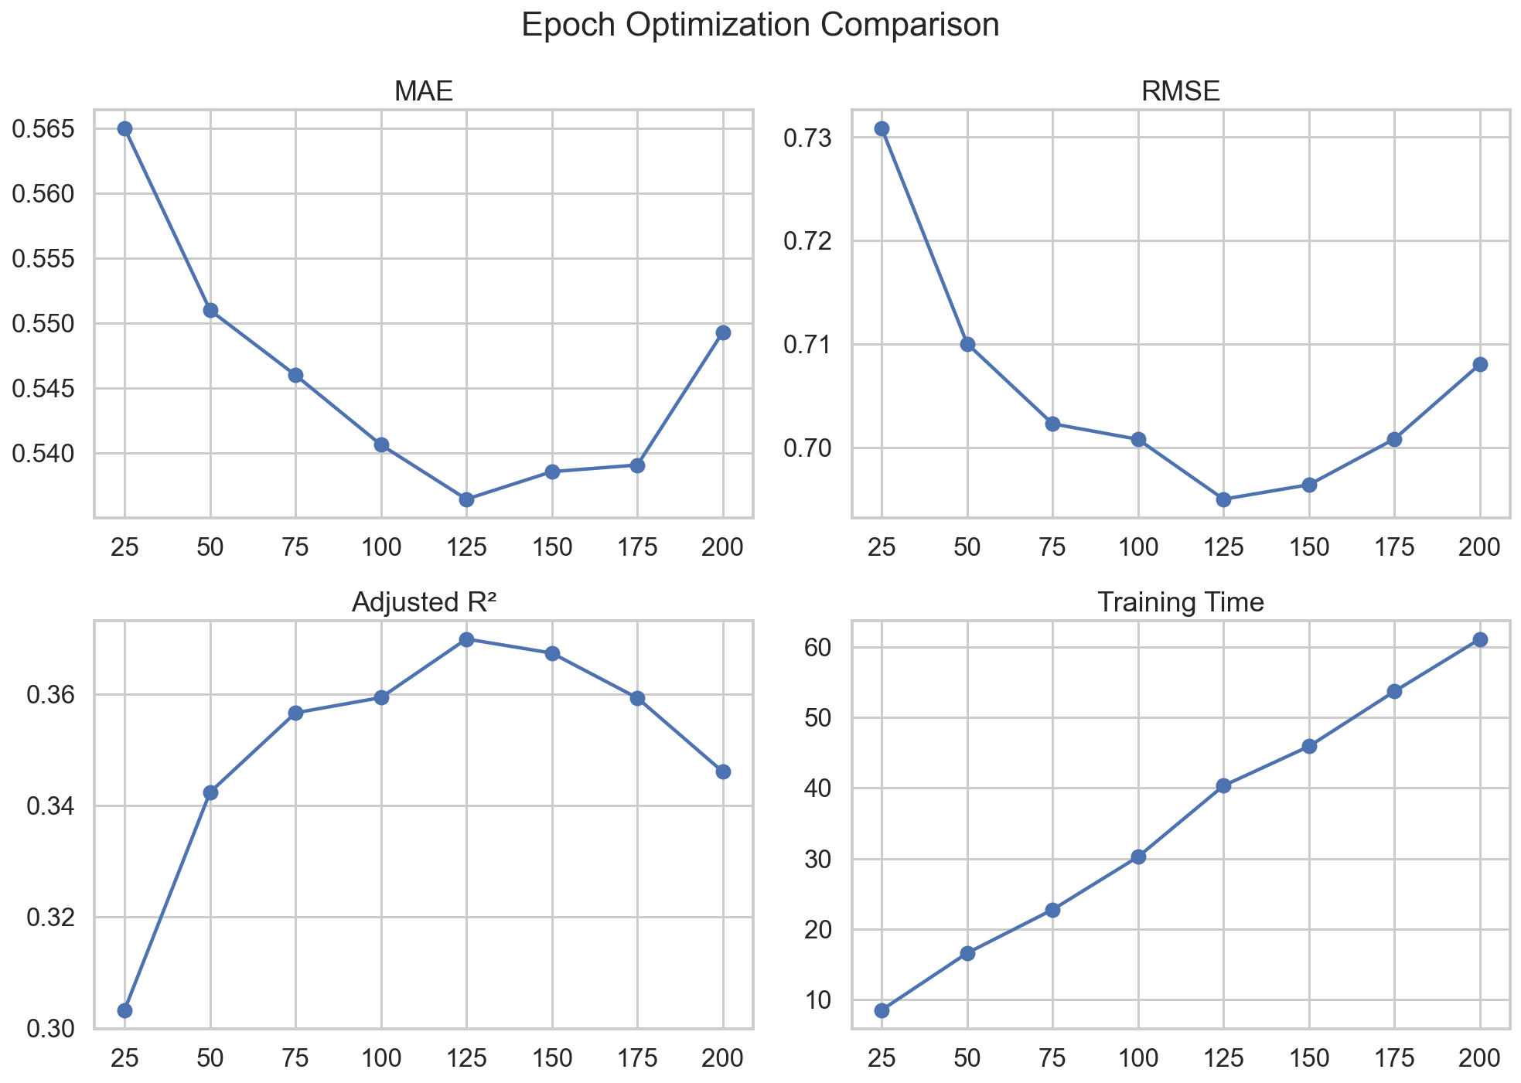
Epoch Study Results
Findings
Performance improved steadily from 25 to 125 epochs.
125 epochs achieved the lowest MAE and RMSE and the highest Adjusted R².
Performance declined slightly beyond 125 epochs.
Training time increased substantially with additional epochs.
Interpretation
Additional epochs initially improved model learning.
Gains diminished after 125 epochs, while computational cost continued to increase.
Conclusion
🏆 Winner: 125 Epochs
Achieved the lowest prediction error and highest Adjusted R² without the unnecessary training cost associated with longer training durations.

Slide 22
Optimizer Benchmarking
Objective
Determine which optimization algorithm produces the strongest predictive performance while holding all other components constant.
Why Optimizers Matter
Optimizers control how neural network weights are updated during training.
The choice of optimizer directly affects:
Convergence speed
Stability
Computational efficiency
Final model accuracy
SGD (Stochastic Gradient Descent)
Traditional optimization method
Simpler update mechanism
Often requires additional tuning
RMSProp
Adaptive learning-rate optimizer
Designed for faster convergence
Well-suited for neural networks
Adam
Combines momentum and adaptive learning rates
Widely used deep-learning optimizer
Strong baseline performer

Slide 23
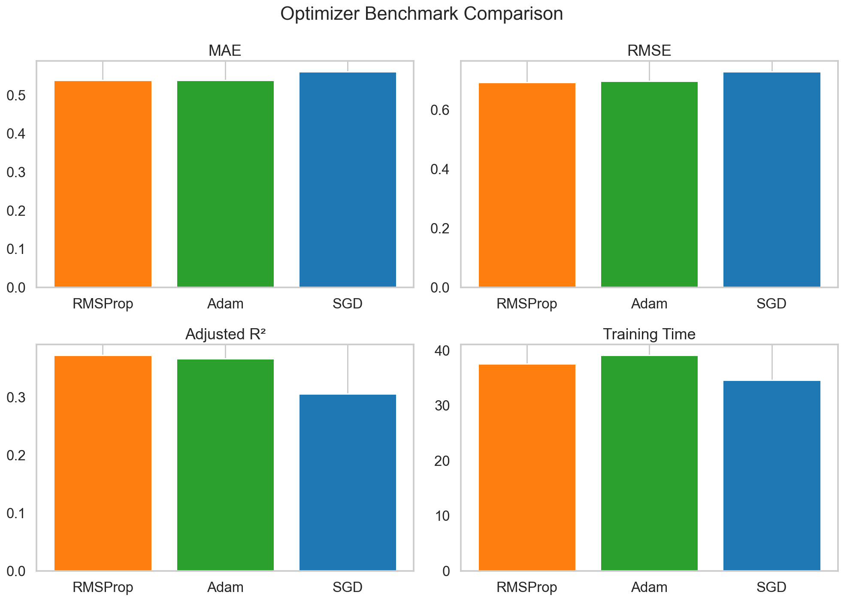
Optimizer Benchmarking Results
Findings
RMSProp achieved the best overall performance.
Adam produced similar results but did not outperform RMSProp.
SGD had the highest error and lowest Adjusted R².
Adaptive optimizers outperformed traditional gradient descent.
Interpretation
Optimizer selection influenced model accuracy.
RMSProp provided the strongest balance of performance and efficiency.
Conclusion
Winner: RMSProp
Best balance of:
Prediction Accuracy
Model Generalization
Training Efficiency

Slide 24
Regularization and Generalization
Objective
Evaluate the impact of regularization techniques on predictive accuracy, model robustness, and generalization performance.
Why Regularization Matters
Neural networks may memorize training data instead of learning general patterns.
Regularization helps:
Reduce overfitting
Improve generalization
Increase model robustness
Stabilize training
Method | Purpose
Baseline | No regularization
L1 | Encourages sparse weights
L2 | Penalizes large weights
Dropout | Randomly disables neurons
Early Stopping | Stops training when improvement stalls

Slide 25
Regularization and Generalization Results
Findings
Baseline achieved the best overall performance.
Early Stopping produced competitive results.
L1 and L2 reduced predictive performance.
Additional regularization provided limited benefit.
Interpretation
The model generalized effectively without regularization.
Additional constraints reduced predictive accuracy.
Conclusion
Winner: Baseline (No Regularization)
Prediction Accuracy
Generalization
Model Simplicity
Best balance of:
Method | MAE | RMSE | Adjusted R²
Baseline | 0.5383 | 0.6933 | 0.3731
Early Stopping | 0.5378 | 0.6941 | 0.3716
Dropout | 0.5497 | 0.7043 | 0.3530
L2 | 0.5627 | 0.7299 | 0.3051
L1 | 0.6967 | 0.8796 | -0.0092

Slide 26
Final Model Selection
Objective
Identify the strongest-performing neural network configuration discovered throughout the optimization process.
Why Was This Model Selected?
Best overall predictive performance.
Highest Adjusted R².
Lowest RMSE among tested configurations.
Strong convergence behavior.
Stable generalization performance.
Fully reproducible experimental workflow.
Conclusion
The final model combines the strongest-performing choices from every optimization stage.
Together, these components produced the best balance of predictive accuracy, training stability, reproducibility, and model generalization.
Final Configuration
MLP
Sigmoid
Model C (64 → 32 → 16)
RMSProp
125 Epochs
No Regularization
StandardScaler

Slide 27
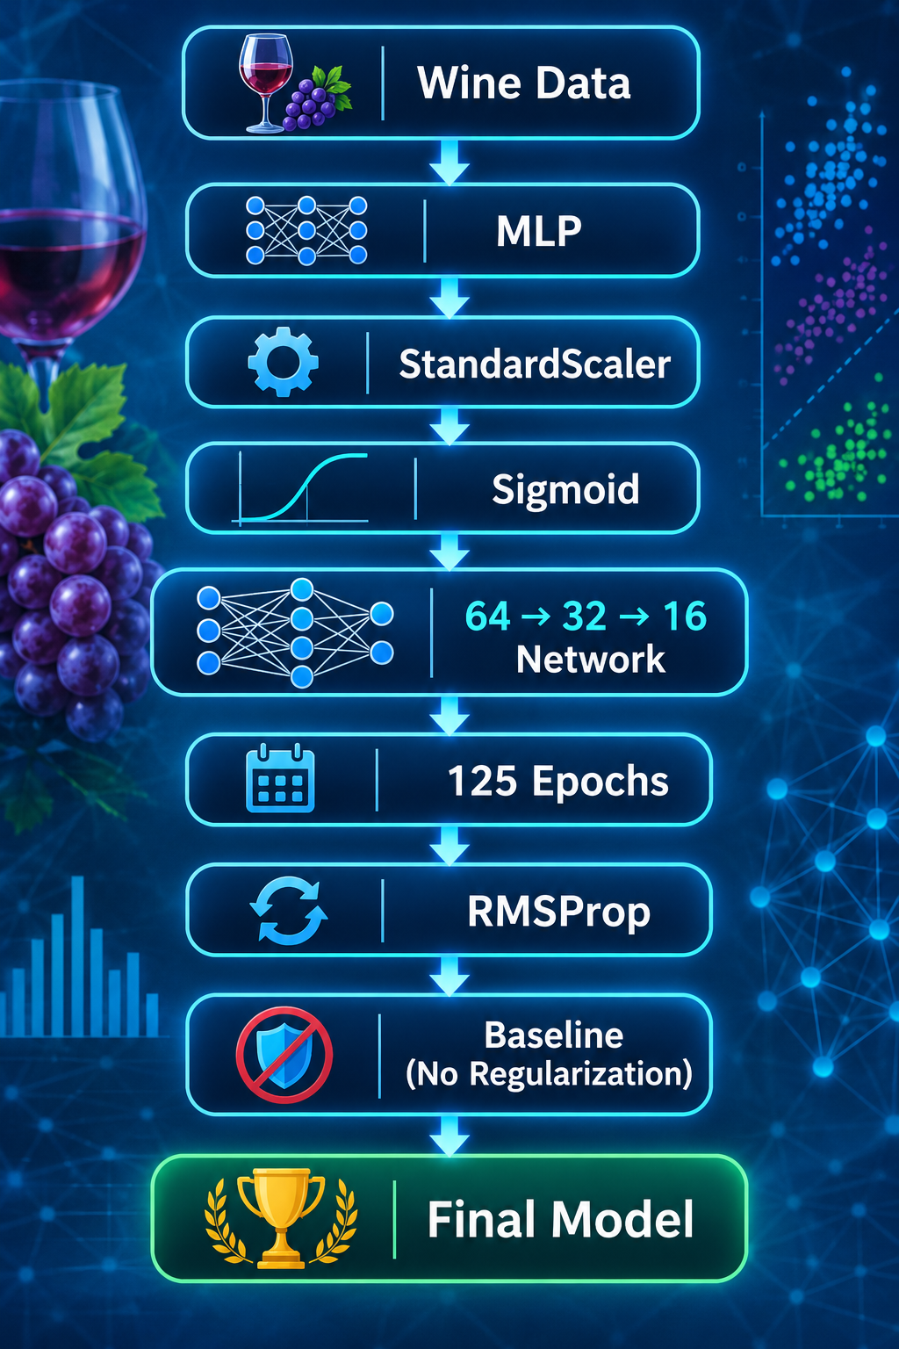
Final Model Structure

Slide 28
Final Model Results
Final Performance Evaluation
Final model outperformed the baseline across all evaluation metrics.
Prediction accuracy improved while maintaining strong generalization.
The model successfully captured relationships between wine chemistry and quality.
Key Findings
Optimization improved overall predictive performance.
Sigmoid and RMSProp delivered the strongest results.
The final architecture consistently outperformed the baseline.
No additional regularization was required.
Conclusion
Optimized Model Selected
Lower Prediction Error
Higher Adjusted R²
Strong Generalization
Metric | Final Model
MAE | 0.5383
RMSE | 0.6933
Adjusted R² | 0.3731
Optimizer | RMSProp
Activation | Sigmoid
Architecture | 64 → 32 → 16
Epochs | 125

Slide 29
Performance Improvement
Findings
MAE improved by 4.89%
RMSE improved by 5.87%
Adjusted R² improved by 27.60%
Every optimization stage contributed to performance gains.
Interpretation
Incremental improvements accumulated throughout the optimization workflow.
Preprocessing, architecture design, training strategy, and optimization choices collectively strengthened model performance.
Conclusion
Final Model Outperformed the Baseline MLP Model
Lower Prediction Error
Higher Explanatory Power
Better Overall Performance
Metric | Baseline MLP | Final Model
MAE | 0.5660 | 0.5383
RMSE | 0.7365 | 0.6933
Adjusted R² | 0.2924 | 0.3731

Slide 30
Dataset Limitations
Dataset Feature Limitations
The Wine Quality dataset contains only physicochemical measurements and excludes several real-world factors that may influence wine quality, including:
Grape variety
Region of origin
Production methods
Storage conditions
Climate and harvest conditions
Expert tasting notes
Quality Score Limitations
Wine quality scores are based on human sensory evaluations.
Subjective scoring introduces variability between evaluators.
Similar wines may receive different ratings.
Some factors affecting quality may not be captured by chemical measurements alone.
Class Distribution Limitations
Most wines received quality scores between 5 and 6.
Very high-quality and very low-quality wines are underrepresented.
Imbalanced target distributions can make prediction more challenging.
Key Takeaway
Although the dataset provides valuable chemistry information, it does not fully capture all factors that influence wine quality. Additional variables could improve predictive performance and model interpretability.
Notes:
The dataset supplied sufficient information for neural network modeling, but several important contributors to wine quality are unavailable. Future models may benefit from incorporating sensory, environmental, and production-related information in addition to chemistry measurements.

Slide 31
Method Limitations
Architecture Search
Only four architectures evaluated.
Additional architectures may perform better.
Hyperparameters
Model Interpretability
Neural networks function as black-box models.
Predictions are difficult to explain.
Generalization
Results are specific to the Wine Quality dataset.
Performance may differ on other datasets.
Key Takeaway
Best model identified from evaluated configurations.
Limited hyperparameter tuning.
Learning rates and batch sizes not fully explored.
Additional optimization opportunities remain.

Slide 32
Next Steps
Hyperparameter Optimization
Learning Rates
Batch Sizes
Weight Initialization
Training Schedules
Architecture Exploration
Deeper Networks
Wider Layers
Residual Networks
Modern DL Architectures
Advanced Regularization
Batch Normalization
Learning-Rate Scheduling
Improved Dropout
Weight Decay
Explainable AI
SHAP Values
Feature Importance
Model Interpretability
Ensemble Approaches
Multiple Neural Networks
Hybrid ML Approaches
Ensemble Models
Long-Term Goal Develop a more accurate, robust, and explainable wine-quality prediction framework.

Slide 33
Project Conclusion
Key Findings
StandardScaler improved performance.
Final Recommended Model
Final Takeaway
MAE ↓ 4.89%
RMSE ↓ 5.87%
Adjusted R² ↑ 27.60%
Systematic optimization transformed the baseline neural network into a stronger and more reliable predictive model.
Sigmoid was the best activation function.
Model C (64 → 32 → 16) achieved the best architecture balance.
125 Epochs optimized training.
RMSProp was the strongest optimizer.
No Regularization produced the best results.
Notes:
One of the most important lessons from this project is that no single design decision was responsible for the final model's success. Performance improvements were achieved through a sequence of optimization studies, each contributing incremental gains. Collectively, these analyses resulted in a model that improved RMSE by 5.87%, MAE by 4.89%, and Adjusted R² by 27.60% compared with the original baseline neural network.

